Slide 1
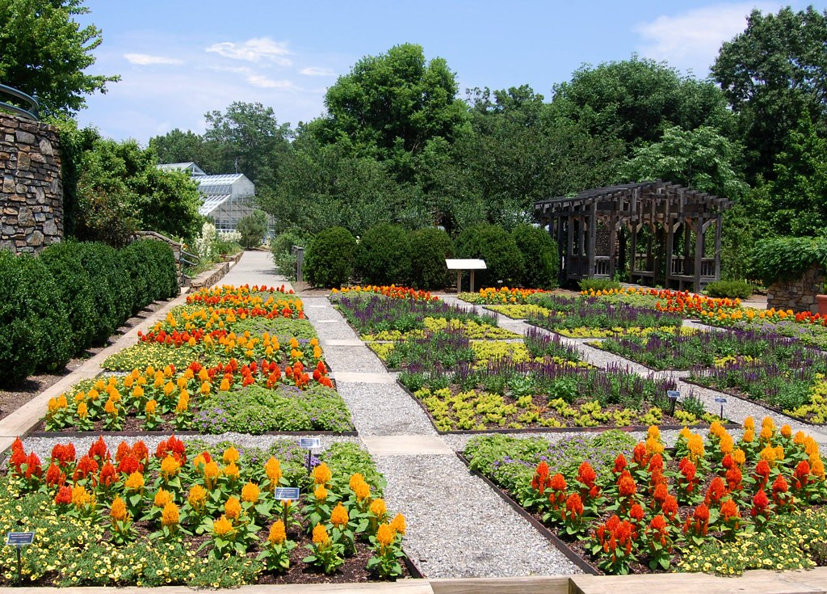
Heritage Arboretum Development Project-3
GROUP-1
Bothsa, Indrani
Saraswat, Gaurav
Singh, Neha
Wadhwa, Vaishnavi Gopal
08-06-2024

Slide 2
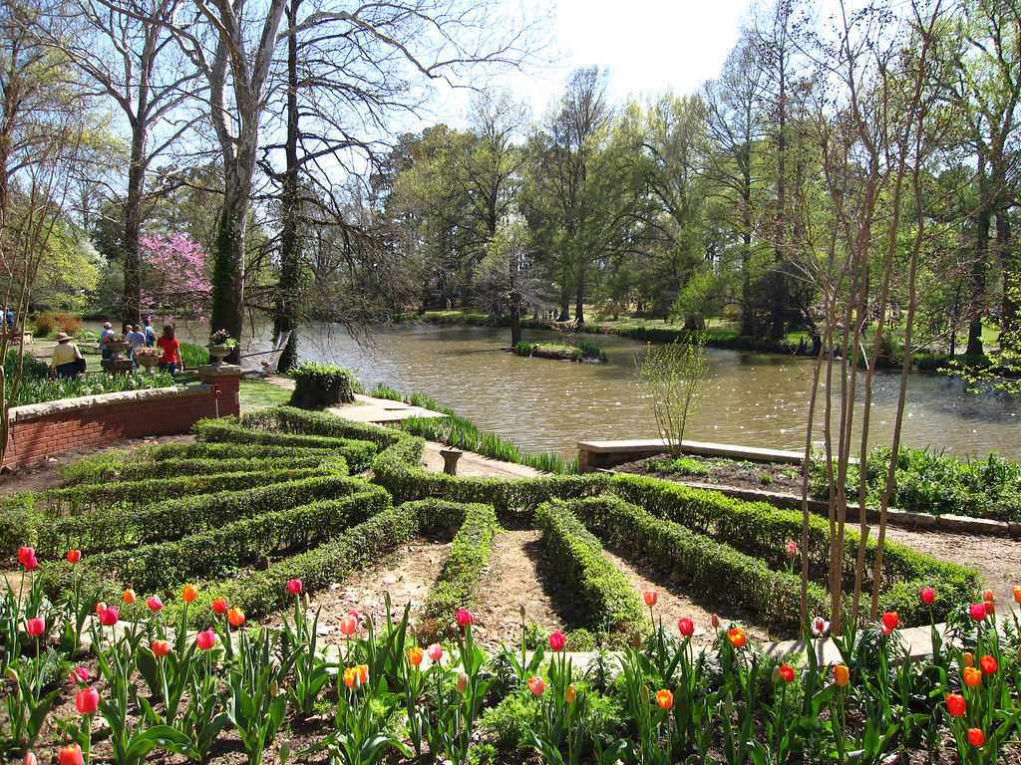
Agenda
Budgeting Process
Structure for accepting donations
Accepting and supervising donated services
Pre-mortem Risk Matrix
Assessment of Big Risks
Response plans
Showstoppers
Improvements for the Project
Three main components of the project
Persona from stakeholders POV
Conclusion

Slide 3
Menti meter Budgeting result

Slide 4
Budgeting Process
Formalize the Budget
Centralized Sources of Financing
Extensive Prediction
Periodic Reviews
Grant applications and sponsorships

Slide 5
Structure for accepting donations
Establish Criteria
Donation group
Documentation Procedure
Donation Agreement
Plan Regular reviews

Slide 6

Accepting and supervising donated services
Service Needs Assessment
Volunteer Qualification Requirements
Volunteer Roles and Responsibilities
Volunteer Coordination Team
Training and Orientation
Supervision and Monitoring
Feedback Mechanism
Recognition and Awards

Slide 7
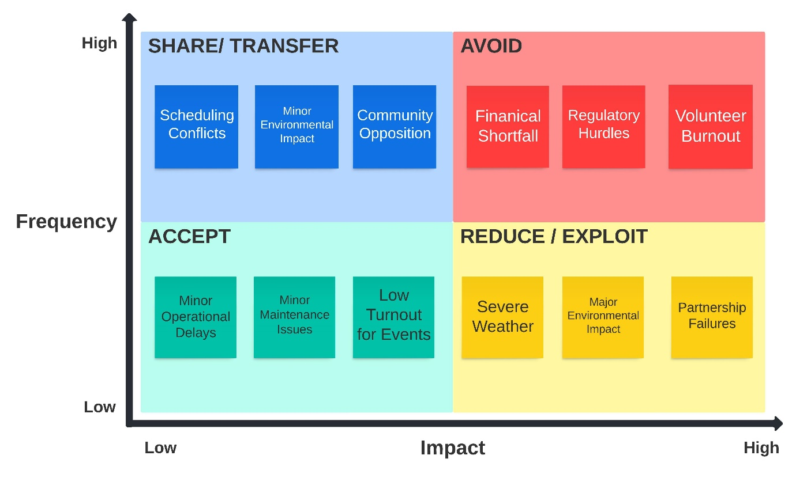
Pre-mortem Risk Matrix
(Murphy. A, 2023, para. 5)
Notes:
A premortem is a project management strategy that will help you prepare for every twist and turn.
Think about what could happen in a project - good or bad - and make a plan before it starts.

Slide 8
Assessment of Big Risks
(Murphy. A, 2023, para. 5)
Notes:
halted progress, or even the project's failure
failing to meet regulatory standards can stop the project entirely or result in legal penalties.
Volunteer burnout can severely affect the project’s progress since the project heavily depends on volunteers.

Slide 9
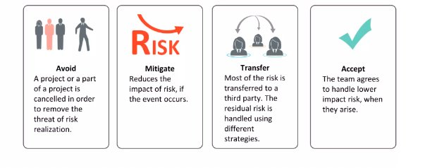
Response plans
Risk | Severity/ Priority | Owner | Triggers | Response
Financial Shortfall | High/ High | Project Finance Manager | Unexpected expenses resulted in higher project costs. Major contributors withdrew or reduced their contributions. Slower-than-anticipated fundraising attempts. | Create a multifaceted fundraising plan that includes grants, business sponsorships, and neighbourhood fundraising activities. Create an emergency savings account to pay unforeseen costs. To maintain financial stability, examine and modify the budget on a regular basis. Keep in constant contact with stakeholders and contributors to keep their interest and support.

Slide 10
Response plans
Risk | Severity/ Priority | Owner | Triggers | Response
Regulatory Hurdles | High/ High | Legal and Compliance Officer | Delays in getting the required authorization. Modifications to regional environmental or zoning legislation. Legal challenges or resistance from neighborhood associations | Retain regular contact with regulatory agencies and local government officials. To expedite the permission process, work with a consultant skilled in local rules. Early in the project, carry out in-depth zoning and environmental investigations. Create a legal backup plan in case there are obstacles or delays.
Volunteer Burnout | High/ High | Volunteer Coordinator | A decline in volunteer involvement and engagement. Volunteer feedback expressing high levels of stress or discontent. A rise in volunteer turnover or absence | Put in place a volunteer management system to keep tabs on roles, hours worked, and levels of involvement. Arrange frequent breaks and events to honor the contributions of volunteers. Provide choices for flexible volunteering to meet varying schedules and prevent people from working too much. Offer assistance and training to volunteers so they may carry out their tasks efficiently and happily.
Response plans

Slide 11


Showstoppers Risk
Financial Shortfall- Risk-Based Spike Plan:
Detail Analysis
Manage Fund raising efforts
Create Back up plan
Regulatory Hurdles- Mitigation Strategies
Analyze Requirements
Manage Permit Requests
Collaborate with environmental organisations

Slide 12
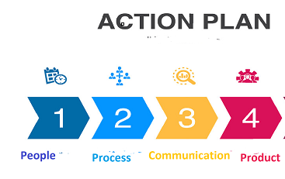

Slide 13
Improvements for the Project
Enhanced Community Engagement
Sustainable Practices
Expanded Educational Programs
Improved Online Presence
Feedback and Iteration
Volunteer Program
Accessibility Enhancements

Slide 14
Three main components of the project
Physical Facility of the Arboretum | Online Presence | Partnering and Programming
Planning Complete | Content Finalized | Program Plan Developed
Site Preparation | Design Completed | Partnerships Established
Trees Acquired | Implementation | Content Prepared
Planting Executed | Quality Check | Marketing and Promotion
Initial Maintenance | Feedback Incorporated | Program Execution
Documentation Updated | Documentation | Feedback Collected
Stakeholder Review | Accessibility Ensured | Evaluation Report

Slide 15
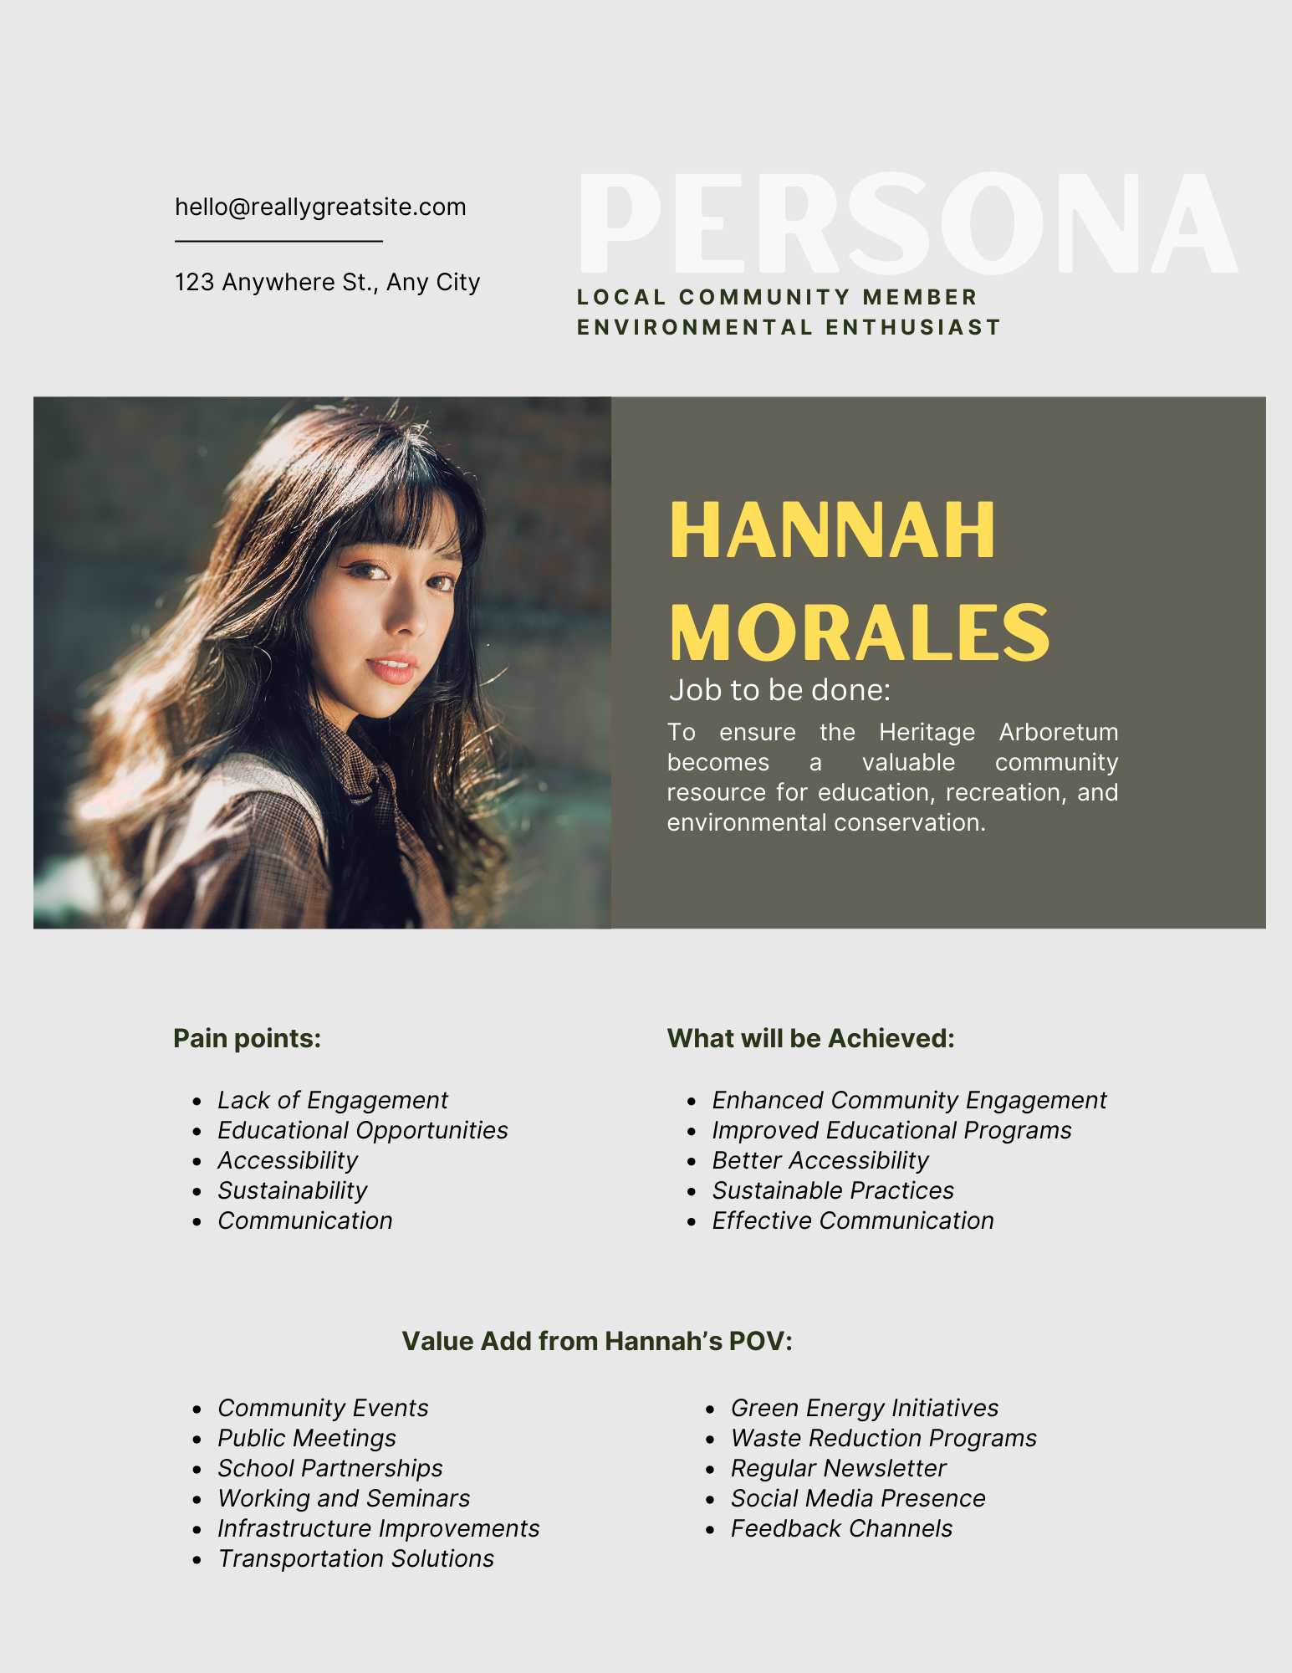
Persona from stakeholders POV

Slide 16

Conclusion
In conclusion, the Heritage Arboretum Development Project has successfully implemented comprehensive risk mitigation strategies, sustainable practices, and community engagement initiatives. These efforts have ensured the project's financial stability, regulatory compliance, and volunteer satisfaction. As a result, the arboretum is poised to become a vibrant, resilient space that fosters environmental stewardship and community connection.

Slide 17
Menti meter Take away result

Slide 18
References
Murphy, A. (2023, April 13). How to Run a Pre-Mortem
https://www.antmurphy.me/newsletter/2023/4/13/pre-mortems
Lucid spark. 2024. 4T risk management. Template
https://lucid.app/lucidspark
Conestoga College. (2024). Heritage Arboretum Development Project Part 3.pdf
https://conestoga.desire2learn.com/d2l/common/viewFile.d2lfile/Database/MTM5MzEyNTk3/Heritage%20Arboretum%20Development%20Project_Part%203.pdf?ou=1123618
Canva. 2024. Grey CV Staff Finance. Resume Template
https://www.canva.com/design/DAGMubK3A0s/QfzdcVPZvjDSxX9VjurwbQ/edit

